Slide 1
Chapter 8: FLOW IN PIPES
Chao-Lung Ting
Department of Engineering Science and Ocean Engineering
National Taiwan University
Fall 2014

Slide 2
Objectives
Have a deeper understanding of laminar and turbulent flow in pipes and the analysis of fully developed flow
Calculate the major and minor losses associated with pipe flow in piping networks and determine the pumping power requirements
Understand the different velocity and flow rate measurement techniques and learn their advantages and disadvantages

Slide 3
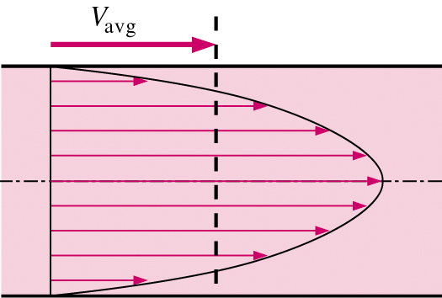
Introduction
Average velocity in a pipe
  Recall - because of the no-slip condition, the velocity at the walls of a pipe or duct flow is zero
  We are often interested only in V_{avg}, which we usually call just V (drop the subscript for convenience)
  Keep in mind that the no-slip condition causes shear stress and friction along the pipe walls
Friction force of wall on fluid

Slide 4

Introduction
For pipes of constant diameter and incompressible flow
  V_{avg} stays the same down the pipe, even if the velocity profile changes
    Why? Conservation of Mass
V_{avg}
V_{avg}
same
same
same

Slide 5
Introduction
For pipes with variable diameter, m is still the same due to conservation of mass, but V₁ ≠ V₂
D₁
D₂
V₁
m
V₂
m
2
1

Slide 6
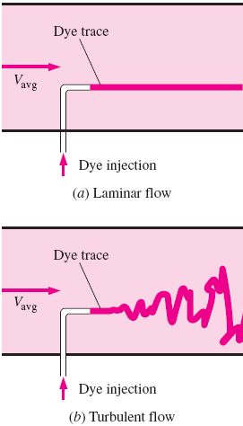
LAMINAR AND TURBULENT FLOWS
Laminar flow: characterized by smooth streamlines and highly ordered motion.
Turbulent flow: characterized by velocity fluctuations and highly disordered motion.
The transition from laminar to turbulent flow does not occur suddenly; rather, it occurs over some region in which the flow fluctuates between laminar and turbulent flows before it becomes fully turbulent.

Slide 7

Reynolds Number
The transition from laminar to turbulent flow depends on the geometry, surface roughness, flow velocity, surface temperature, and type of fluid, among other things.
British engineer Osborne Reynolds (1842–1912) discovered that the flow regime depends mainly on the ratio of inertial forces to viscous forces in the fluid.
The ratio is called the Reynolds number and is expressed for internal flow in a circular pipe as

Slide 8
Reynolds Number
At large Reynolds numbers, the inertial forces are large relative to the viscous forces ⇒ Turbulent Flow
At small or moderate Reynolds numbers, the viscous forces are large enough to suppress these fluctuations ⇒ Laminar Flow
The Reynolds number at which the flow becomes turbulent is called the critical Reynolds number, Re_{cr}.
The value of the critical Reynolds number is different for different geometries and flow conditions. For example, Re_{cr} = 2300 for internal flow in a circular pipe.

Slide 9
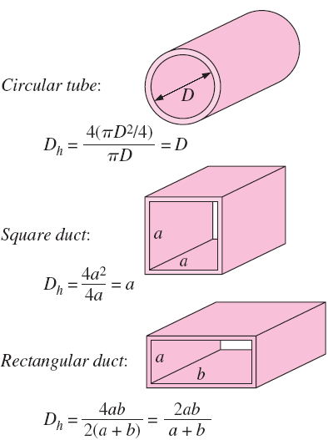

Reynolds Number
For flow through noncircular pipes, the Reynolds number is based on the hydraulic diameter D_{h} defined as
  A_{c} = cross-section area
  P = wetted perimeter
The transition from laminar to turbulent flow also depends on the degree of disturbance of the flow by surface roughness, pipe vibrations, and fluctuations in the flow.

Slide 10
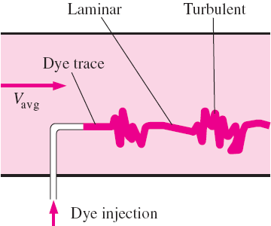
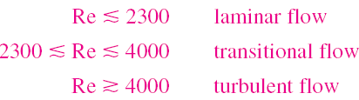
Reynolds Number
Under most practical conditions, the flow in a circular pipe is
In transitional flow, the flow switches between laminar and turbulent randomly.

Slide 11
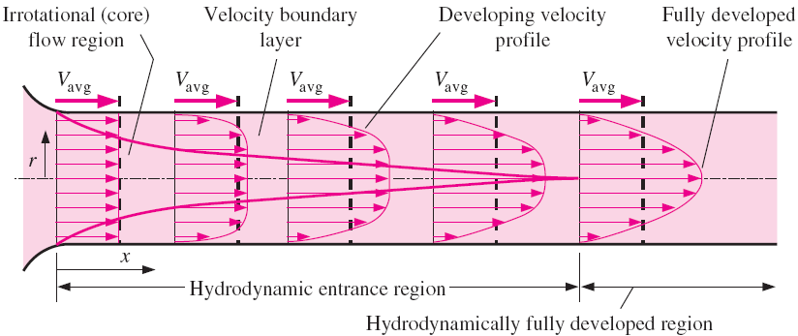
THE ENTRANCE REGION
Consider a fluid entering a circular pipe at a uniform velocity.

Slide 12
THE ENTRANCE REGION
The velocity profile in the fully developed region is parabolic in laminar flow and somewhat flatter (or fuller) in turbulent flow.
The time-averaged velocity profile remains unchanged when the flow is fully developed, and thus u = u(r) only.
The velocity profile remains unchanged in the fully developed region, so does the wall shear stress.
The wall shear stress is the highest at the pipe inlet where the thickness of the boundary layer is smallest, and decreases gradually to the fully developed value. Therefore, the pressure drop is higher in the entrance regions of a pipe.

Slide 13
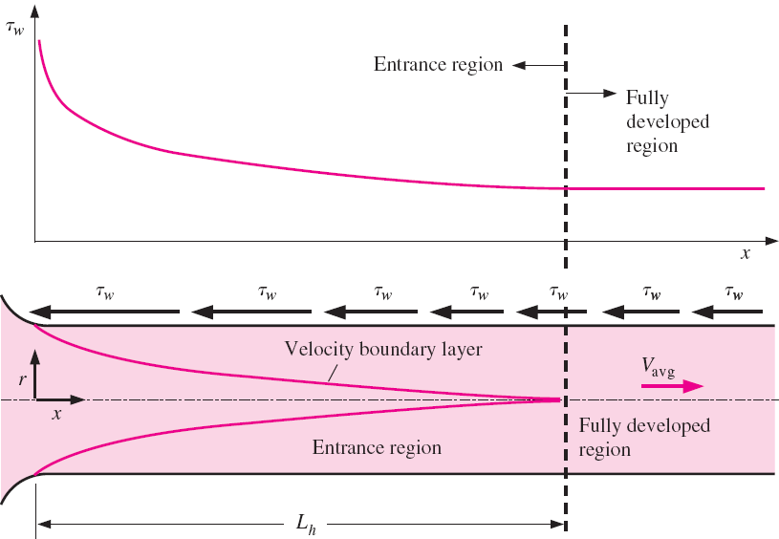
THE ENTRANCE REGION

Slide 14


Entry Lengths
The hydrodynamic entry length is usually taken to be the distance from the pipe entrance to where the wall shear stress (and thus the friction factor) reaches within about 2 percent of the fully developed value.
In laminar flow, the hydrodynamic entry length is given approximately as
In turbulent flow, the hydrodynamic entry length for turbulent flow can be approximated as
The entry length is much shorter in turbulent flow, as expected, and its dependence on the Reynolds number is weaker.

Slide 15
Entry Lengths
In the limiting laminar case of Re 2300, the hydrodynamic entry length is 115D.
In many pipe flows of practical engineering interest, the entrance effects for turbulent flow become insignificant beyond a pipe length of 10 diameters, and the hydrodynamic entry length is approximated as
In turbulent flow, it is reasonable to assume the flow is fully developed for a pipe whose length is several times longer than the length of its entrance region.

Slide 16
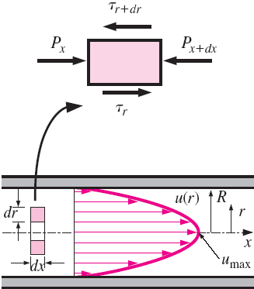
LAMINAR FLOW IN PIPES
In this section we consider the steady laminar flow of an incompressible fluid with constant properties in the fully developed region of a straight circular pipe.
In fully developed laminar flow, each fluid particle moves at a constant axial velocity along a streamline and no motion in the radial direction such that no acceleration (since flow is steady and fully-developed).

Slide 17


LAMINAR FLOW IN PIPES
Now consider a ring-shaped differential volume element of radius r, thickness dr, and length dx oriented coaxially with the pipe. A force balance on the volume element in the flow direction gives
Dividing by 2πdrdx and rearranging,

Slide 18


LAMINAR FLOW IN PIPES
Taking the limit as dr, dx → 0 gives
Substituting τ = -μ(du/dr) gives the desired equation,
The left side of the equation is a function of r, and the right side is a function of x. The equality must hold for any value of r and x; therefore, f (r) = g(x) = constant.

Slide 19
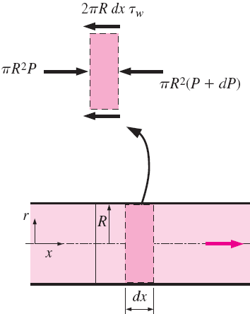

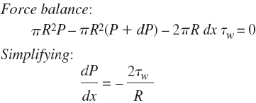

LAMINAR FLOW IN PIPES
Thus we conclude that dP/dx = constant and we can verify that
Here τ_{w} is constant since the viscosity and the velocity profile are constants in the fully developed region. Then we solve the u(r) eq. by rearranging and integrating it twice to give
r²

Slide 20


LAMINAR FLOW IN PIPES
Since ∂u/∂r = 0 at r = 0 (because of symmetry about the centerline) and u = 0 at r = R, then we can get u(r)
Therefore, the velocity profile in fully developed laminar flow in a pipe is parabolic. Since u is positive for any r, and thus the dP/dx must be negative (i.e., pressure must decrease in the flow direction because of viscous effects).
The average velocity is determined from

Slide 21


LAMINAR FLOW IN PIPES
The velocity profile is rewritten as
Thus we can get
Therefore, the average velocity in fully developed laminar pipe flow is one half of the maximum velocity.

Slide 22


Pressure Drop and Head Loss
The pressure drop ∆P of pipe flow is related to the power requirements of the fan or pump to maintain flow. Since dP/dx = constant, and integrating from x = x₁ where the pressure is P₁ to x = x₁ + L where the pressure is P₂ gives
The pressure drop for laminar flow can be expressed as
∆P due to viscous effects represents an irreversible pressure loss, and it is called pressure loss ∆P_{L} to emphasize that it is a loss.

Slide 23


Pressure Drop and Head Loss
The pressure drop represents the pressure loss ∆P_{L} (No viscosity ⇒ No loss)
In practice, it is found convenient to express the pressure loss for all types of fully developed internal flows as
It is also called the Darcy–Weisbach friction factor, named after the Frenchman Henry Darcy (1803–1858) and the German Julius Weisbach (1806–1871)

Slide 24


Pressure Drop and Head Loss
It should not be confused with the friction coefficient C_{f}, Fanning friction factor, which is defined as
C_{f} = 2τ_{w} / (ρV²_{avg}) = f /4.
The friction factor for fully developed laminar flow in a circular pipe
In the analysis of piping systems, pressure losses are commonly expressed in terms of the equivalent fluid column height, called the head loss h_{L}.
(independent of the roughness)
(Frictional losses due to viscosity)

Slide 25



Pressure Drop and Head Loss
Once the pressure loss (or head loss) is known, the required pumping power to overcome the pressure loss is determined from
The average velocity for laminar flow in a horizontal pipe is
The volume flow rate for laminar flow through a horizontal pipe becomes
This equation is known as Poiseuille’s law, and this flow is called Hagen–Poiseuille flow.

Slide 26
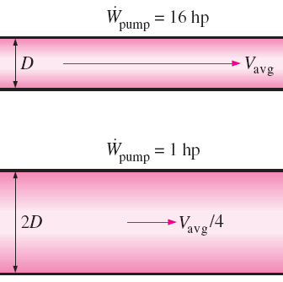
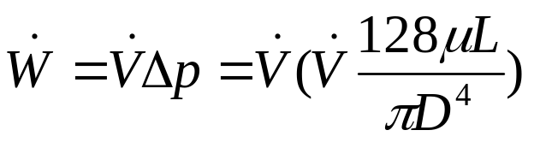
Pressure Drop and Head Loss ⎯ Poiseuille’s law
For a specified flow rate, the pressure drop and thus the required pumping power is proportional to the length of the pipe and the viscosity of the fluid, but it is inversely proportional to the fourth power of the radius (or diameter) of the pipe.
Since

Slide 27

Pressure Drop and Head Loss (Skipped)
In the above cases, the pressure drop equals to the head loss, but this is not the case for inclined pipes or pipes with variable cross-sectional area.
Let’s examine the energy equation for steady, incompressible one-dimensional flow in terms of heads as
Or
From the above eq., when the pressure drop = the head loss?

Slide 28
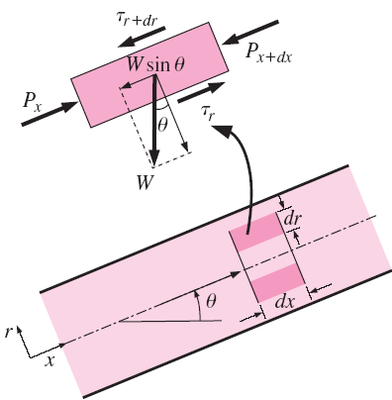


Pressure Drop and Head Loss ⎯ Inclined Pipes
Analogous to horizontal pipe. Read by yourself
Similar to the horizontal pipe flow, except there is an additional force which is the weight component in the flow direction whose magnitude is

Slide 29



Pressure Drop and Head Loss ⎯ Inclined Pipes
The force balance now becomes
which results in the differential equation
The velocity profile can be shown to be

Slide 30


Pressure Drop and Head Loss ⎯ Inclined Pipes
The average velocity and the volume flow rate relations for laminar flow through inclined pipes are, respectively,
Note that θ > 0 and thus sin θ > 0 for uphill flow, and θ < 0 and thus sin θ < 0 for downhill flow.

Slide 31
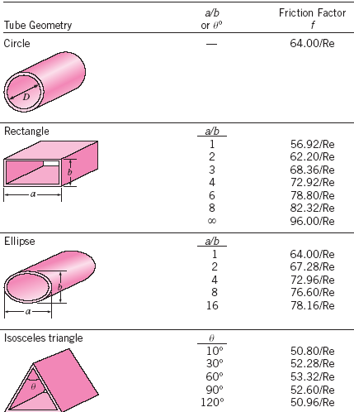
Laminar Flow in Noncircular Pipes
Friction factor for fully developed laminar flow in pipes of various cross sections

Slide 32
TURBULENT FLOW IN PIPES (Skipped)
Most flows encountered in engineering practice are turbulent, and thus it is important to understand how turbulence affects wall shear stress.
However, turbulent flow is a complex mechanism. The theory of turbulent flow remains largely undeveloped.
Therefore, we must rely on experiments and the empirical or semi-empirical correlations developed for various situations.

Slide 33
TURBULENT FLOW IN PIPES (Skipped)
Turbulent flow is characterized by random and rapid fluctuations of swirling regions of fluid, called eddies, throughout the flow.
These fluctuations provide an additional mechanism for momentum and energy transfer.
In laminar flow, momentum and energy are transferred across streamlines by molecular diffusion.
In turbulent flow, the swirling eddies transport mass, momentum, and energy to other regions of flow much more rapidly than molecular diffusion, such that associated with much higher values of friction, heat transfer, and mass transfer coefficients.

Slide 34
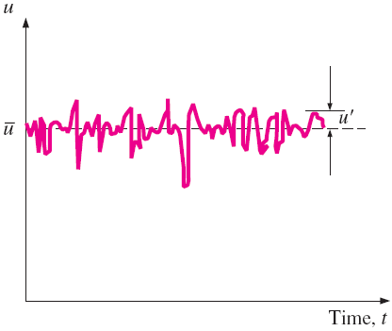
TURBULENT FLOW IN PIPES (Skipped)
Even when the average flow is steady, the eddy motion in turbulent flow causes significant fluctuations in the values of velocity, temperature, pressure, and even density (in compressible flow).
We observe that the instantaneous velocity can be expressed as the sum of an average value and a fluctuating component ,

Slide 35

TURBULENT FLOW IN PIPES (Skipped)
The average value of a property at some location is determined by averaging it over a time interval that is sufficiently large so that the time average levels off to a constant. ⇒
The magnitude of is usually just a few percent of , but the high frequencies of eddies (in the order of a thousand per second) makes them very effective for the transport of momentum, thermal energy, and mass.
The shear stress in turbulent flow can not be analyzed in the same manner as did in laminar flow. Experiments show it is much larger due to turbulent fluctuation.

Slide 36
TURBULENT FLOW IN PIPES (Skipped)
The turbulent shear stress consists of two parts: the laminar component, and the turbulent component,
The velocity profile is approximately parabolic in laminar flow, it becomes flatter or “fuller” in turbulent flow.
The fullness increases with the Reynolds number, and the velocity profile becomes more nearly uniform, however, that the flow speed at the wall of a stationary pipe is always zero (no-slip condition).

Slide 37
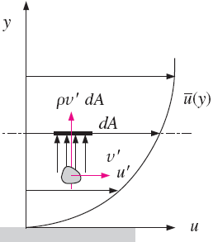

Turbulent Shear Stress (Skipped)
Consider turbulent flow in a horizontal pipe, and the upward eddy motion of fluid particles in a layer of lower velocity to an adjacent layer of higher velocity through a differential area dA
Then the turbulent shear stress can be expressed as

Slide 38



Turbulent Shear Stress (Skipped)
Experimental results show that is usually a negative quantity.
Terms such as or are called Reynolds stresses or turbulent stresses.
Many semi-empirical formulations have been developed that model the Reynolds stress in terms of average velocity gradients. Such models are called turbulence models.
Momentum transport by eddies in turbulent flows is analogous to the molecular momentum diffusion.

Slide 39


Turbulent Shear Stress (Skipped)
In many of the simpler turbulence models, turbulent shear stress is expressed as suggested by the French mathematician Joseph Boussinesq in 1877 as
where μ_{t} the eddy viscosity or turbulent viscosity, which accounts for momentum transport by turbulent eddies.
The total shear stress can thus be expressed conveniently as
where ν_{t} = μ_{t} /ρ is the kinematic eddy viscosity or kinematic turbulent viscosity (also called the eddy diffusivity of momentum).

Slide 40

Turbulent Shear Stress (Skipped)
For practical purpose, eddy viscosity must be modeled as a function of the average flow variables; we call this eddy viscosity closure.
For example, L. Prandtl introduced the concept of mixing length l_{m}, which is related to the average size of the eddies that are primarily responsible for mixing, and expressed the turbulent shear stress as
l_{m} is not a constant for a given flow and its determination is not easy.

Slide 41
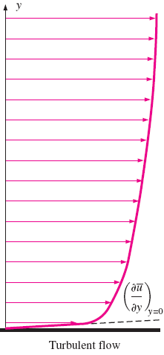
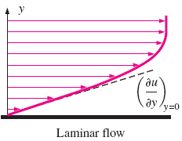
Turbulent Shear Stress (Skipped)
Eddy motion and thus eddy diffusivities are much larger than their molecular counterparts in the core region of a turbulent boundary layer.
The velocity profiles are shown in the figures. So it is no surprise that the wall shear stress is much larger in turbulent flow than it is in laminar flow.
Molecular viscosity is a fluid property; however, eddy viscosity is a flow property.

Slide 42
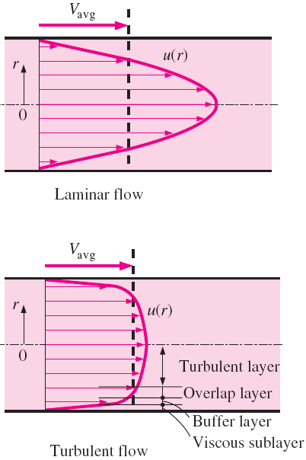
Turbulent Velocity Profile
Typical velocity profiles for fully developed laminar and turbulent flows are given in Figures.
Note that the velocity profile is parabolic in laminar flow but is much fuller in turbulent flow, with a sharp drop near the pipe wall.

Slide 43
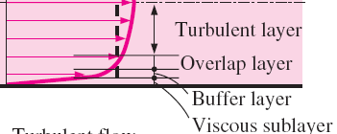
Turbulent Velocity Profile
Turbulent flow along a wall can be considered to consist of four regions, characterized by the distance from the wall.
  Viscous (or laminar or linear or wall) sublayer: where viscous effects are dominant and the velocity profile in this layer is very nearly linear, and the flow is streamlined.
  Buffer layer: viscous effects are still dominant: however, turbulent effects are becoming significant.
  Overlap (or transition) layer (or the inertial sublayer): the turbulent effects are much more significant, but still not dominant.
  Outer (or turbulent) layer: turbulent effects dominate over molecular diffusion (viscous) effects.

Slide 44
Turbulent Velocity Profile (Skipped)
The Viscous sublayer (next to the wall):
  The thickness of this sublayer is very small (typically, much less than 1 % of the pipe diameter), but this thin layer plays a dominant role on flow characteristics because of the large velocity gradients it involves.
  The wall dampens any eddy motion, and thus the flow in this layer is essentially laminar and the shear stress consists of laminar shear stress which is proportional to the fluid viscosity.
  The velocity profile in this layer to be very nearly linear, and experiments confirm that.

Slide 45



Turbulent Velocity Profile (Viscous sublayer)
(Skipped)
The velocity gradient in the viscous sublayer remains nearly constant at du/dy = u/y, and the wall shear stress can be expressed as
where y is the distance from the wall. The square root of τ_{w} /ρ has the dimensions of velocity, and thus it is viewed as a fictitious velocity called the friction velocity expressed as
The velocity profile in the viscous sublayer can be expressed in dimensionless form as

Slide 46

Turbulent Velocity Profile (Viscous sublayer)
(Skipped)
This equation is known as the law of the wall, and it is found to satisfactorily correlate with experimental data for smooth surfaces for 0 ≤ yu*/ν ≤ 5.
Therefore, the thickness of the viscous sublayer is roughly
where u_{δ} is the flow velocity at the edge of the viscous sublayer, which is closely related to the average velocity in a pipe. Thus we conclude the viscous sublayer is suppressed and it gets thinner as the velocity (and thus the Reynolds number) increases. Consequently, the velocity profile becomes nearly flat and thus the velocity distribution becomes more uniform at very high Reynolds numbers.

Slide 47

Turbulent Velocity Profile (Viscous sublayer)
(Skipped)
The quantity ν/u* is called the viscous length; it is used to nondimensionalize the distance y; then we can get nondimensionalized velocity defined as
Then the normalized law of wall becomes simply
Note that y⁺ resembles the Reynolds number expression.

Slide 48


Turbulent Velocity Profile (Overlap layer)
(Skipped)
In the overlap layer, experiments confirm that the velocity is proportional to the logarithm of distance, and the velocity profile can be expressed as
where κ and B are constants and determined experimentally to be about 0.40 and 5.0, respectively. Equation 8–46 is known as the logarithmic law. Thus the velocity profile is
It is viewed as a universal velocity profile for turbulent flow in pipes or over surfaces.
(8-46)
(8-47)

Slide 49
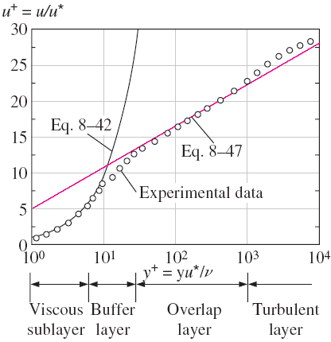
Turbulent Velocity Profile (Overlap layer)
(Skipped)
Note from the figure that the logarithmic-law velocity profile is quite accurate for y⁺ > 30, but neither velocity profile is accurate in the buffer layer, i.e., the region 5 < y⁺ < 30. Also, the viscous sublayer appears much larger in the figure.

Slide 50

Turbulent Velocity Profile (Turbulent layer)
(Skipped)
A good approximation for the outer turbulent layer of pipe flow can be obtained by evaluating the constant B by setting y = R – r = R and u = u_{max}, an substituting it back into Eq. 8–46 together with κ = 0.4 gives
The deviation of velocity from the centerline value u_{max} - u is called the velocity defect, and Eq. 8–48 is called the velocity defect law. It shows that the normalized velocity profile in the turbulent layer for a pipe is independent of the viscosity of the fluid. This is not surprising since the eddy motion is dominant in this region, and the effect of fluid viscosity is negligible.
(8-48)

Slide 51

Turbulent Velocity Profile
(Skipped)
Numerous other empirical velocity profiles exist for turbulent pipe flow. Among those, the simplest and the best known is the power-law velocity profile expressed as
where the exponent n is a constant whose value depends on the Reynolds number. The value of n increases with increasing Reynolds number. The value n = 7 generally approximates many flows in practice, giving rise to the term one-seventh power-law velocity profile.

Slide 52
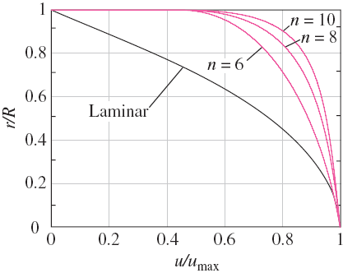
Turbulent Velocity Profile
(Skipped)
Note that the power-law profile cannot be used to calculate wall shear stress since it gives a velocity gradient of infinity there, and it fails to give zero slope at the centerline. But these regions of discrepancy constitute a small portion of flow, and the power-law profile gives highly accurate results for turbulent flow through a pipe.

Slide 53
Turbulent Velocity Profile
(Skipped)
The characteristics of the flow in viscous sublayer are very important since they set the stage for flow in the rest of the pipe. Any irregularity or roughness on the surface disturbs this layer and affects the flow. Therefore, unlike laminar flow, the friction factor in turbulent flow is a strong function of surface roughness.
The roughness is a relative concept, and it has significance when its height ε is comparable to the thickness of the laminar sublayer (which is a function of the Reynolds number). All materials appear “rough” under a microscope with sufficient magnification. In fluid mechanics, a surface is characterized as being rough when ε > δ_{sublayer} and is said to be smooth when ε < δ_{sublayer} . Glass and plastic surfaces are generally considered to be hydrodynamically smooth.

Slide 54
The Moody Chart
The friction factor in fully developed turbulent pipe flow depends on the Reynolds number and the relative roughness ε/D, which is the ratio of the mean height of roughness of the pipe to the pipe diameter.
It is no way to find a mathematical closed form for friction factor by theoretical analysis; therefore, all the available results are obtained from painstaking experiments.
Most such experiments were conducted by Prandtl’s student J. Nikuradse in 1933, followed by the works of others. The friction factor was calculated from the measurements of the flow rate and the pressure drop.
Functional forms were obtained by curve-fitting experimental data.

Slide 55

The Moody Chart
In 1939, Cyril F. Colebrook combined the available data for transition and turbulent flow in smooth as well as rough pipes into the Colebrook equation:
In 1942, the American engineer Hunter Rouse verified Colebrook’s equation and produced a graphical plot of f.
In 1944, Lewis F. Moody redrew Rouse’s diagram into the form commonly used today, called Moody chart given in the appendix as Fig. A–12.

Slide 56
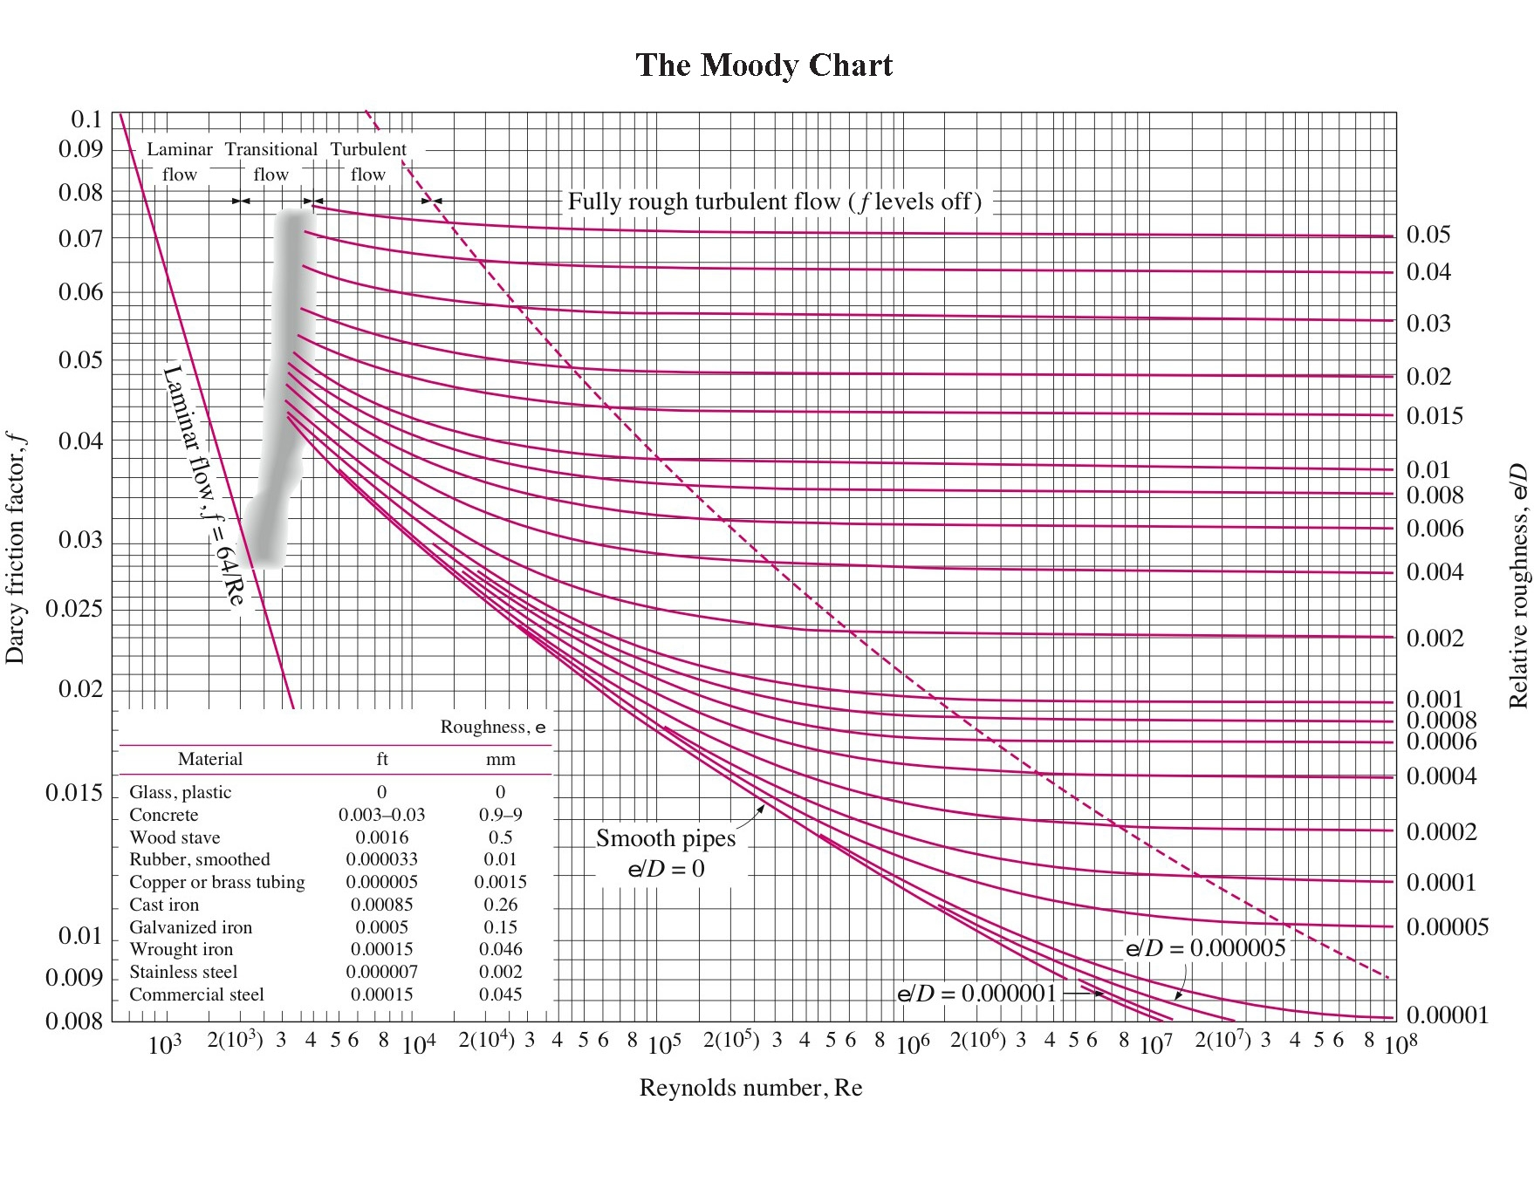

Slide 57
The Moody Chart
The Moody chart presents the Darcy friction factor for pipe flow as a function of the Reynolds number and ε/D over a wide range. It is probably one of the most widely accepted and used charts in engineering. Although it is developed for circular pipes, it can also be used for noncircular pipes by replacing the diameter by the hydraulic diameter.
Both Moody chart and Colebrook equation are accurate to ±15% due to roughness size, experimental error, curve fitting of data, etc

Slide 58
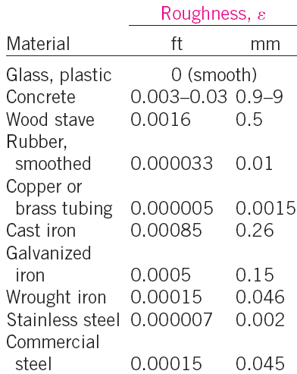
Equivalent roughness values for new commercial pipes

Slide 59
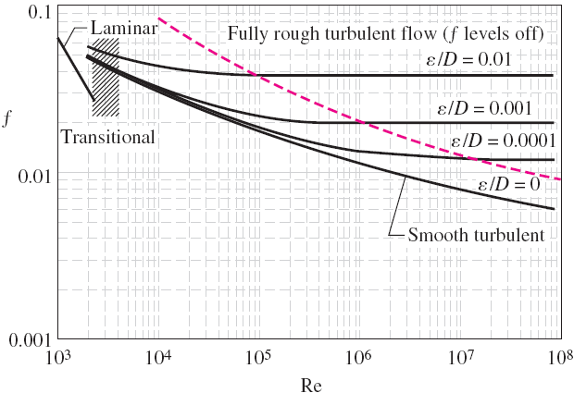
Observations from the Moody chart
For laminar flow, the friction factor decreases with increasing Reynolds number, and it is independent of surface roughness.
The friction factor is a minimum for a smooth pipe and increases with roughness
The data in the transition region are the least reliable.

Slide 60



Observations from the Moody chart
In the transition region, at small relative roughnesses, the friction factor increases and approaches the value for smooth pipes.
At very large Reynolds numbers, the friction factor curves corresponding to specified relative roughness curves are nearly horizontal, and thus the friction factors are independent of the Reynolds number. The flow in that region is called fully rough turbulent flow or just fully rough flow

Slide 61
Types of Fluid Flow Problems
In design and analysis of piping systems, 3 problem types are encountered
  Determine Δp (or h_{L}) given L, D, V (or flow rate)
    Can be solved directly using Moody chart and Colebrook equation
  Determine V, given L, D, Δp
  Determine D, given L, Δp, V (or flow rate)
Types 2 and 3 are common engineering design problems, i.e., selection of pipe diameters to minimize construction and pumping costs
However, iterative approach required since both V and D are in the Reynolds number.

Slide 62
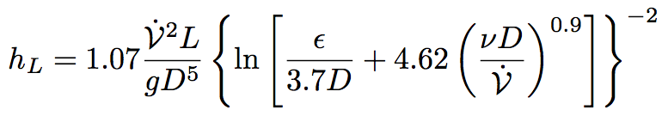


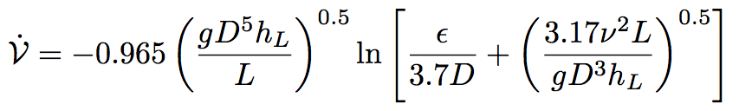

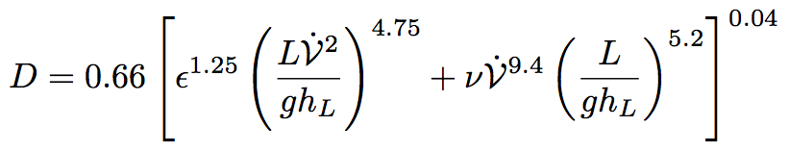

Types of Fluid Flow Problems
Explicit relations have been developed which eliminate iteration. They are useful for quick, direct calculation, but introduce an additional 2% error

Slide 63
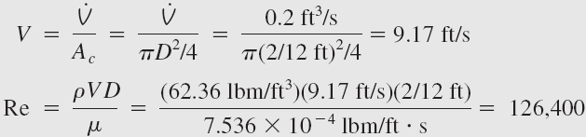

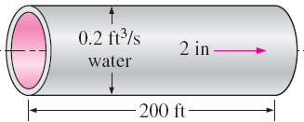





EXAMPLE 8–3: Determining the Head Loss in a Water Pipe
Solution:
Water at 60°F (ρ = 62.36 lbm/ft³ and μ = 7.536 × 10⁻⁴ lbm/ft · s) is flowing steadily in a 2-in-diameter horizontal pipe made of stainless steel at a rate of 0.2 ft³/s. Determine the pressure drop, the head loss, and the required pumping power input for flow over a 200-ft-long section of the pipe.
Using an equation solver or an iterative scheme, the friction factor is determined to be f = 0.0174.
Therefore,
which is greater than 4000. Therefore, the flow is turbulent. The relative
roughness of the pipe is calculated using Table 8–2
The friction factor can simply be determined from the Moody chart. To avoid any reading error, we determine f from the Colebrook equation:

Slide 64
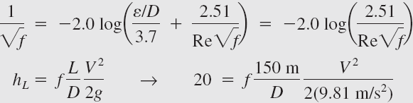
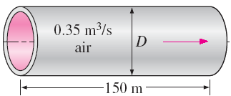
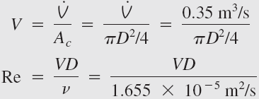


EXAMPLE 8–4 Determining the Diameter of an Air Duct
Solution:
This is a problem of the third type. We can solve this problem by three different approaches:
An iterative approach by assuming a pipe diameter, calculating the head loss, comparing the result to the specified head loss, and repeating calculations until the calculated head loss matches the specified value;
Writing all the relevant equations (leaving the diameter as an unknown) and solving them simultaneously using an equation solver;
Using the third Swamee–Jain formula. We will demonstrate the use of the last two approaches.
Heated air at 1 atm and 35°C is to be transported in a 150-m-long circular plastic duct at a rate of 0.35 m³/s, If the head loss in the pipe is not to exceed 20 m, determine the minimum diameter of the duct.
The roughness is approximately zero for a plastic pipe (Table 8–2).
Solving for the four equations, then we can get
Note that Re > 4000, and thus the turbulent flow assumption is verified.
The diameter can also be determined directly from the third Swamee–Jain formula to be
Method (2)

Slide 65
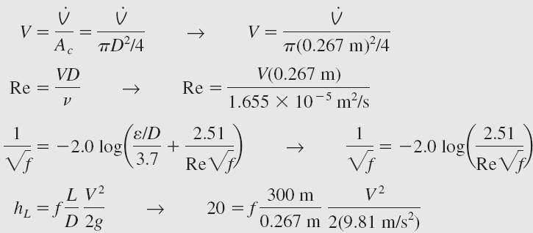
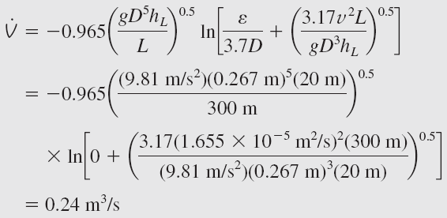

EXAMPLE 8–5 Determining the Flow Rate of Air in a Duct
Solution:
The new flow rate can also be determined directly from the second
Swamee–Jain formula to be
Method (2)
Reconsider Example 8–4. Now the duct length is doubled while its diameter is maintained constant. If the total head loss is to remain constant, determine the drop in the flow rate through the duct.
Solving them
Then the drop in the flow rate becomes

Slide 66
Minor Losses
Piping systems include fittings, valves, bends, elbows, tees, inlets, exits, enlargements, and contractions.
These components interrupt the smooth flow of fluid and cause additional losses because of flow separation and mixing.
The head loss introduced by a completely open valve may be negligible. But a partially closed valve may cause the largest head loss in the system which is evidenced by the drop in the flow rate.
We introduce a relation for the minor losses associated with these components as follows.

Slide 67

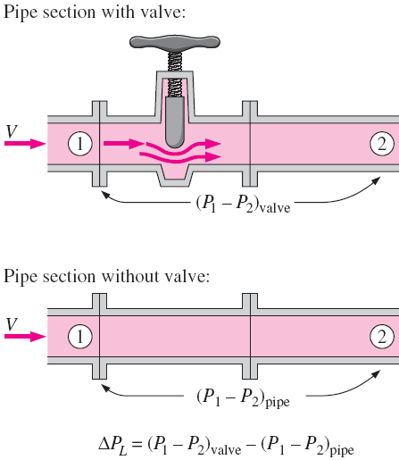

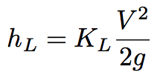
Minor Losses
K_{L} is the loss coefficient (also called the resistance coefficient).
Is different for each component.
Is assumed to be independent of Re (Since Re is very large).
Typically provided by manufacturer or generic table (e.g., Table 8-4 in text).

Slide 68

Minor Losses
The minor loss occurs locally across the minor loss component, but keep in mind that the component influences the flow for several pipe diameters downstream.
This is the reason why most flow meter manufacturers recommend installing their flow meter at least 10 to 20 pipe diameters downstream of any elbows or valves.
Minor losses are also expressed in terms of the equivalent length L_{equiv}, defined as

Slide 69

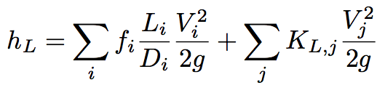
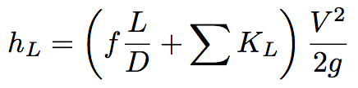
Minor Losses
Total head loss in a system is comprised of major losses (in the pipe sections) and the minor losses (in the components)
If the piping system has constant diameter
i pipe sections
j components

Slide 70
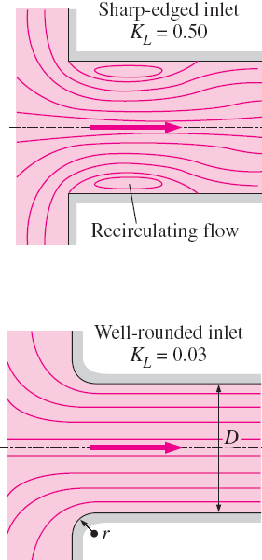
Head loss at the inlet of a pipe
The head loss at the inlet of a pipe is a strong function of geometry. It is almost negligible for well-rounded inlets (K_{L} = 0.03 for r/D = 0.2), but increases to about 0.50 for sharp-edged inlets (because the fluid cannot make sharp 90° turns easily, especially at high velocities; therefore, the flow separates at the corners).
The flow is constricted into the vena contracta region formed in the midsection of the pipe.

Slide 71
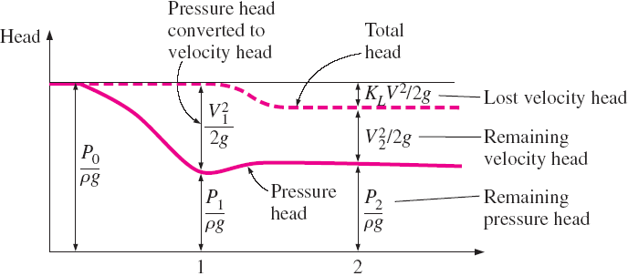
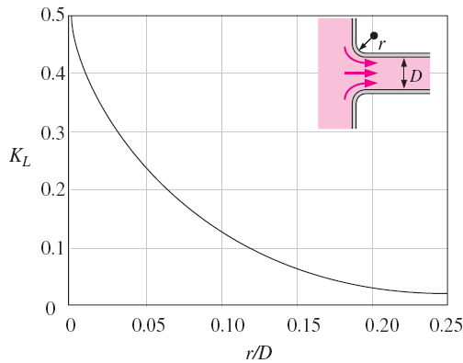
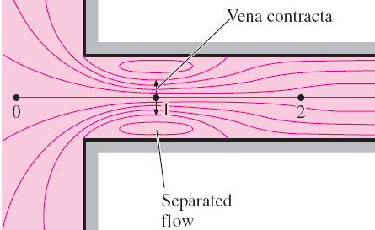
Head loss at the inlet of a pipe

Slide 72
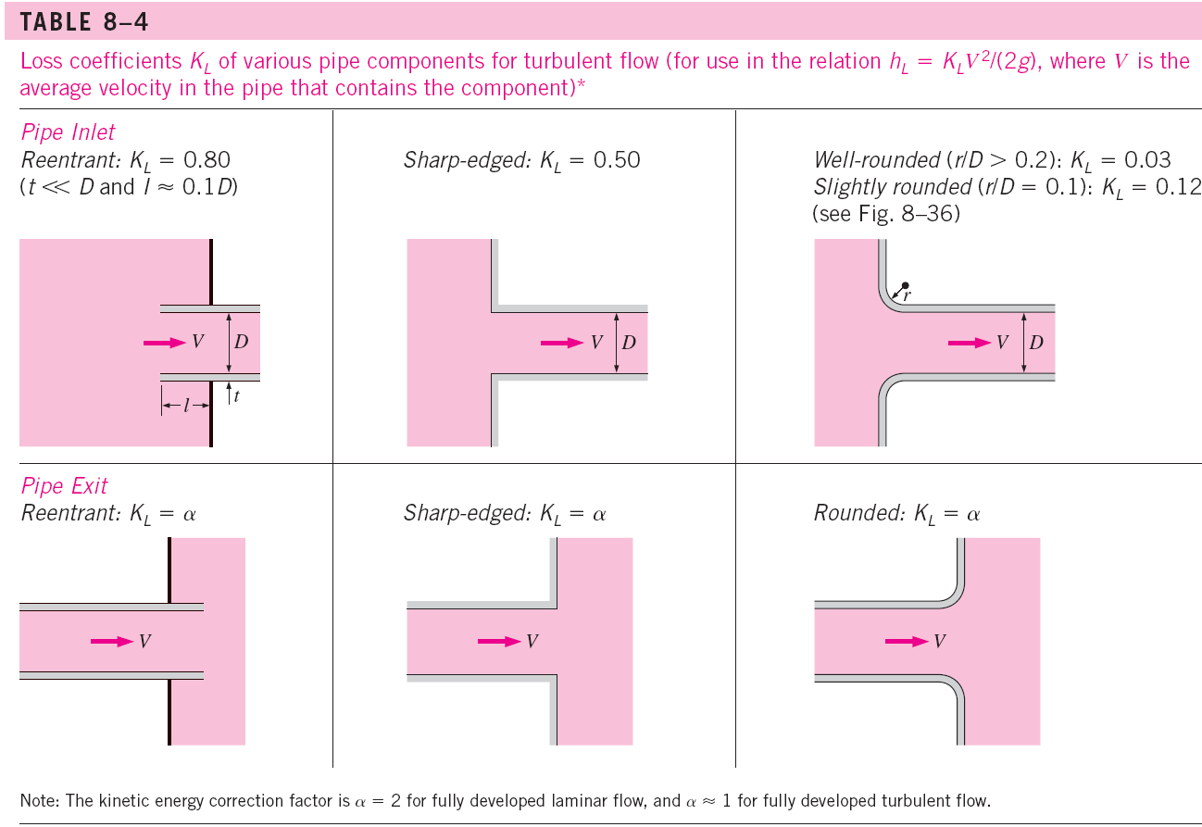
Whether laminar or turbulent, the fluid leaving the pipe loses all of its kinetic energy as it mixes with the reservoir fluid and eventually comes to rest

Slide 73
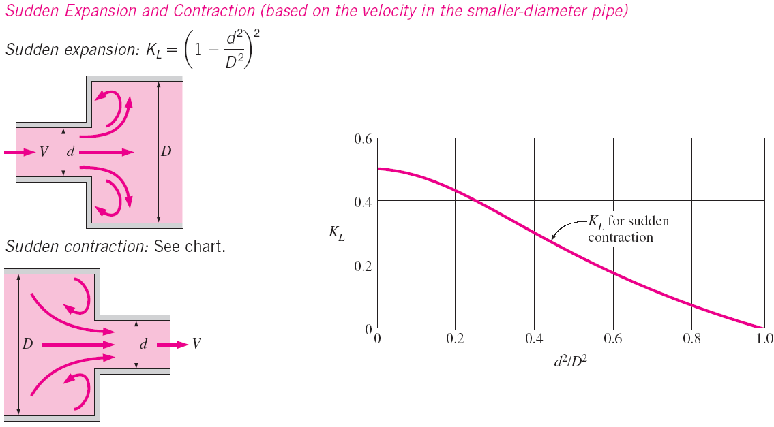

Slide 74
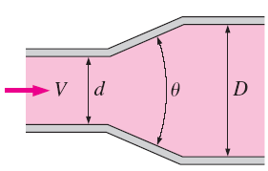
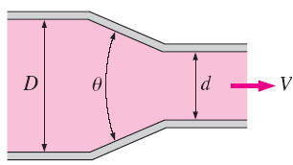
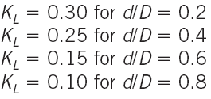

Gradual Expansion and Contraction (based on the velocity in the smaller-diameter pipe)
Typos in the text

Slide 75
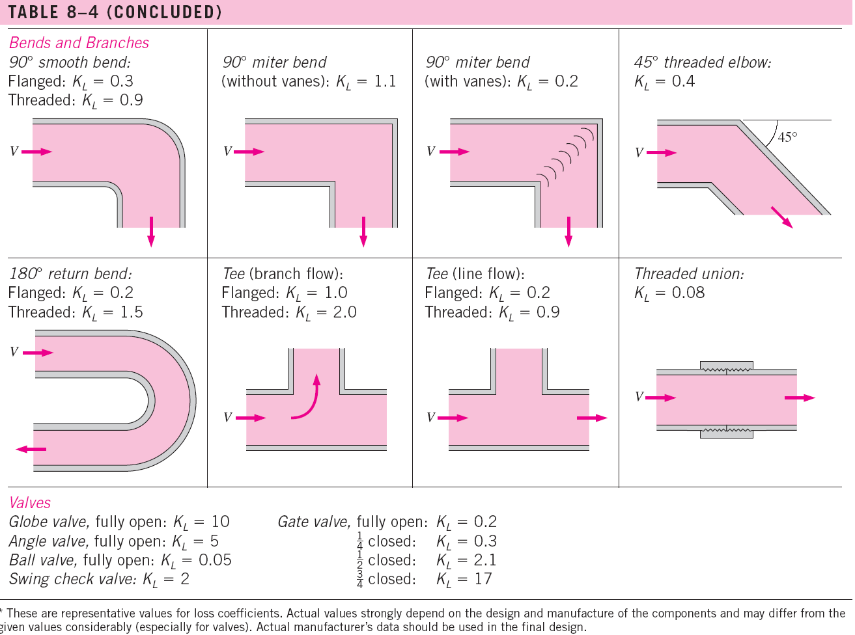

Slide 76
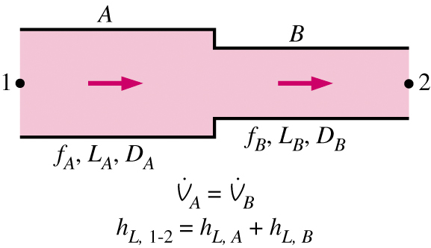

Piping Networks and Pump Selection
Two general types of networks
  Pipes in series
    Volume flow rate is constant
    Head loss is the summation of parts
  Pipes in parallel
    Volume flow rate is the sum of the components
    Pressure loss across all branches is the same

Slide 77





Piping Networks and Pump Selection
For parallel pipes, perform CV analysis between points A and B
Since Δp is the same for all branches, head loss in all branches is the same

Slide 78


Piping Networks and Pump Selection
Head loss relationship between branches allows the following ratios to be developed
Real pipe systems result in a system of non-linear equations.
Note: the analogy with electrical circuits should be obvious
  Flow flow rate (V_{A}) : current (I)
  Pressure gradient (Δp) : electrical potential (V)
  Head loss (h_{L}): resistance (R), however h_{L} is very nonlinear

Slide 79
Piping Networks and Pump Selection
The analysis of piping networks, no matter how complex they are, is based on two simple principles:
  Conservation of mass throughout the system must be satisfied.
  Pressure drop (and thus head loss) between two junctions must be the same for all paths between the two junctions.

Slide 80

Piping Networks and Pump Selection
When a piping system involves pumps and/or turbines, pump and turbine head must be included in the energy equation
The useful head of the pump (h_{pump,u}) or the head extracted by the turbine (h_{turbine,e}), are functions of volume flow rate, i.e., they are not constants.
Operating point of system is where the system is in balance, e.g., where pump head is equal to the head losses.

Slide 81


Pump and systems curves
Supply curve (or characteristic or performance curves) for h_{pump,u}: determine experimentally by manufacturer.
System (or demand) curve determined from analysis of fluid dynamics equations
Operating point is the intersection of supply and demand curves
If peak efficiency is far from operating point, pump is wrong for that application.
Examples on pages from 358 to 364
In the text

Slide 82

EXAMPLE 8–7 Pumping Water through Two Parallel Pipes
Water at 20°C is to be pumped from a reservoir (z_{A} = 5 m) to another reservoir at a higher elevation (z_{B} = 13 m) through two 36-m-long pipes connected in parallel.

Slide 83
EXAMPLE 8–7 Pumping Water through Two Parallel Pipes
Water is to be pumped by a 70 percent efficient motor–pump combination that draws 8 kW of electric power during operation. The minor losses and the head loss in pipes that connect the parallel pipes to the two reservoirs are considered to be negligible. Determine the total flow rate between the reservoirs and the flow rate through each of the parallel pipes.
Solution:
Assumptions:
1 The flow is steady and incompressible.
2 The entrance effects are negligible, and the flow is fully developed.

Slide 84

EXAMPLE 8–7 Pumping Water through Two Parallel Pipes
Solution:
3 The elevations of the reservoirs remain constant.
4 The minor losses and the head loss in pipes other than the parallel pipes are said to be negligible.
5 Flows through both pipes are turbulent (to be verified).
The useful head supplied by the pump to the fluid is determined from

Slide 85




EXAMPLE 8–7 Pumping Water through Two Parallel Pipes
The energy equation for a control volume between these two points simplifies to
or
Where
We designate the 4-cm-diameter pipe by 1 and the 8-cm-diameter pipe by 2. The average velocity, the Reynolds number, the friction factor, and the head loss in each pipe are expressed as

Slide 86

EXAMPLE 8–7 Pumping Water through Two Parallel Pipes

Slide 87

EXAMPLE 8–7 Pumping Water through Two Parallel Pipes
This is a system of 13 equations in 13 unknowns, and their simultaneous solution by an equation solver gives

Slide 88

EXAMPLE 8–7 Pumping Water through Two Parallel Pipes
Note that Re > 4000 for both pipes, and thus the assumption of turbulent flow is verified.
Discussion The two parallel pipes are identical, except the diameter of the first pipe is half the diameter of the second one. But only 14 percent of the water flows through the first pipe. This shows the strong dependence of the flow rate (and the head loss) on diameter.

Slide 89
FLOW RATE AND VELOCITY MEASUREMENT
Please see section 8-8 in the text for the detail. There are various devices to measure flow rates.
Two optical methods used to measure velocity fields will be introduced:
  Laser Doppler Velocimetry (LDV)
  Particle Image Velocimetry (PIV)

Slide 90

Laser Doppler Velocimetry (LDV)
LDV is an optical technique to measure flow velocity at any desired point without disturbing the flow.

Slide 91


Laser Doppler Velocimetry (LDV)
When a particle traverses these fringe lines at velocity V, the frequency of the scattered fringe lines is.
Particles with a diameter of 1 μm
The measurement volume resembles an ellipsoid, typically of 0.1 mm diameter and 0.5 mm in length.

Slide 92

Particle Image Velocimetry (PIV)
PIV provides velocity values simultaneously throughout an entire cross section, and thus it is a whole-field technique.

